Slide 1
Airline Reservation System
Amrish K.s (18C008)
Prasanna S (18C070)

Slide 2
Description
Airline Reservation System for people to book tickets. First they login into the website and check for the availability of tickets and the user can view the flight timings, Book Tickets and Cancel Payment. Admin can Add information about the flight timings into it and update further details.

Slide 3
modules
ADMIN LOGIN
Add Flight Details
View Passenger Details
View Payment Details
4. Add Information

Slide 4
USER PAGE (LOGIN/SIGNUP)
Book Tickets
View Flight Timings
Make Payment
Cancel Payment

Slide 5
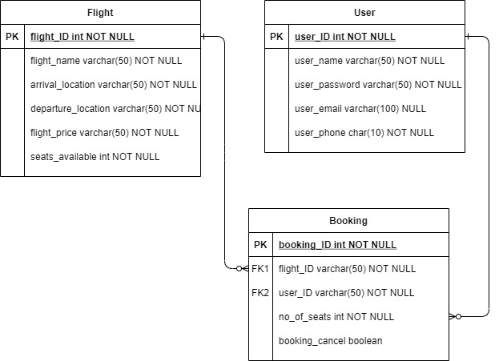
DATABASE DETAILS

